Slide 1

Project Topic:-
Online Food Ordering System
Student Members:-
Aniruddha Sawant (20104011)
Abhishek Shinde (20104007)
Nihaal Varun (20104040)
Prof. Charul Singh

Slide 2
Contents
Introduction
Objectives
Scope
Features /Functionality
Project Outcomes
Technology Stack

Slide 3

Online Food ordering system is a process in which one can order various foods and beverages from some local restaurant and hotels through the use of internet, just by sitting at home or any place. And the order is delivered to the told location.
So food ordering system these days has one of the fastest growing market, though being a new idea. In this project we have developed something like the same to earn from and serve the nation in a much better way possible.

Slide 4

To evaluate the way of interaction with customers.
To develop a restaurant ordering system with mobile application based on the client server application.
To determine the factors that influence customer when ordering food online

Slide 5

Well-designed self-service ordering systems give customers actual control over the pace of their transaction and allow them to limit the amount of personal interaction of restaurant.
Also, with the food ordering system online, people can easily track their orders, and the admin can maintain the customer’s database and advance the food delivery system.
This food ordering system allows the user to select the desired food items from a list of available menu items.

Slide 6
4. Features/Functionalities
Easy Registration and Sign Up
Easy Search
Menu Items/Pictures
Add to Cart and Order Management
Status Updates
Customer Data
Pay Online/Pay in Person
Order Receipt

Slide 7
4.1 Literature Survey
In paper ,along with customer feedback for a restaurant a design and execution of wireless food ordering system was carried out. It enables restaurant owners to setup the system in wireless environment and update menu presentations easily. Smart phone has been integrated in the customizable wireless food ordering system with real- time customer feedback implementation to facilitate real- time communication between restaurant owners and customers.
In Paper , the research work aims to automate the food ordering process in restaurant and also improve the dining experience of customers. Design implementation of food ordering system for restaurants were discuss in this paper. This system implements wireless data access to servers. The android application on user’s mobile will have all the menu details .Kitchen and cashier receive the order details from the customer mobile wirelessly. These order details are updated in the central database. The restaurant owner can manage the menu modifications easily.

Slide 8
In Paper ,the purpose of the study was the application is based on user’s requirement . All issues related to all user which are included in this system are developed by this system. If people know how to operate android smart phone wide variety of people can use the application. This system will solve the various issues related to Mess service. To help and solve important problems of people implementation of Online Food Ordering system is done. It can be concluded that, based on the application: Orders are made easily by this system; Information needed in making order to customer is provided by the system. Receiving orders and modifying its data is possible through the application and it also helps admin in controlling all the Food system.

Slide 9

The final outcome of the project is as follows:
Customers can signup and login for access to home page
With menu details.
It stores information about new entry of food items.
Users login details are being stored in the database with respective timestamps.
After checking out order confirmation and receipt is been
shown.

Slide 10




Frontend: HTML , CSS , JavaScript
Backend: phpMyAdmin , MySql
Server: Xampp
Operating System: Windows11

Slide 11
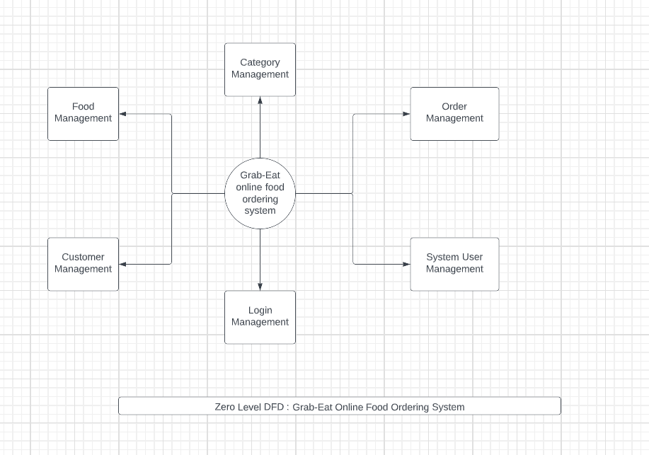
7. Block Diagram

Slide 12
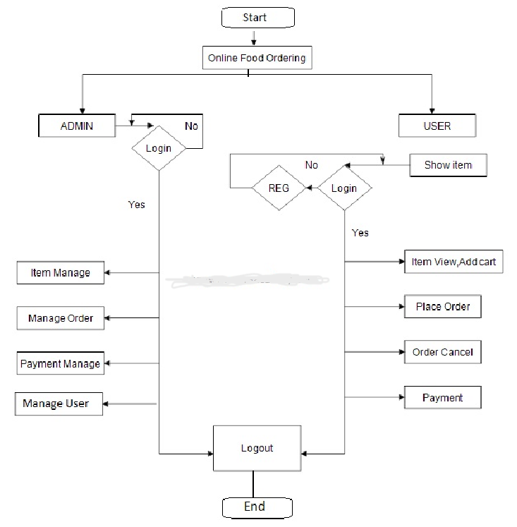
8. Flowchart

Slide 13
9. References
O. I. Mike and A. Simon, “Towards the Digitalization of Hotel Business in Nigeria: The Design Perspective,” vol. 8,no. 2, pp. 1175–1178, 2017.3.
Adithya. R., A. Singh, S. Pathan, and V. Kanade, “Online Food Ordering System,” Int. J. Compute. Appl., vol. 180, no. 6,pp. 22–24, 2017.4.
Varsha Chavan, Priya Jadhav, Snehal Korade, Priyanka Teli,”Implementing Customizable Online Food Ordering System Using Web Based Application”, International Journal of Innovative Science, Engineering Technology(IJISET) 2015.5. Patel, Mayurkumar, "Online Food Order System for Restaurants" (2015). Technical Library. Paper 219.6.
php code available at www.w3schools.com7.
mysql code available at www.stackoverflow.com

Slide 14
10. Review 1 Suggestions:
Work on backend.
Work on payment portal.

Slide 15
Thank You...!!

